Slide 1
Developing Parental Involvement
Shelby Elise Simmons, MAT
Colleton County School District
SCATA Conference October 23, 2013

Slide 2
Professional Development
Who should attend professional development to improve parental involvement?
What does professional development that improves parental involvement look like?
How do you measure success?

Slide 3
Who Should Attend?
Parent Volunteers
Administrators
Teachers
All staff members that regularly communicate with parents – attendance clerks, nurses, bus drivers, and custodians have a role

Slide 4
How do you differentiate?
Offer PD in multiple ways
Tailor to audience and type of interaction
Prioritize groups and topics
Create distance and/or self-paced opportunities
Embed in other PD activities
http://uplift.ccsdtitle1.org/facilitators.html

Slide 5
Topics
Selected based on Needs Assessment data
Annual Parent Survey
Annual Staff Survey
Review of Parent Involvement Plan/Policy
District Objectives
This Year: Technology & Literacy

Slide 6
Topics
Engaging Parents and Students with Technology
Incorporating Technology using the Media Center
Socially Accessible – technology for families with special needs
Reading Skills – Finding Facts/Characterization

Slide 7
Methods and Materials
Books and materials that will be used during sessions
Websites, apps, and activities
Newsletter http://social.shelbyesimmons.me
Email and Social Media
District Teacher Work Days
Staff Meetings

Slide 8
Evaluation
We track # of attendees
We survey:
Attendees
All Parents
Staff
Results:
Increased attendance
Improved survey responses

Slide 9
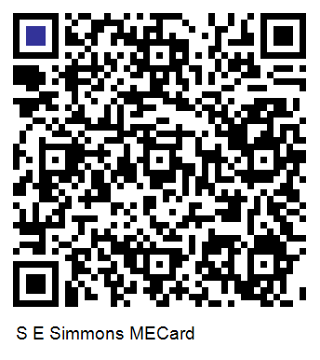
Contact Me!
Shelby Simmons
sesimmons@colletonsd.org
843-782-4522
ccsdtitle1@colletonsd.org

